Slide 1
Mirror writing
In a mirror writing looks back-to-front.
AMBULANCE
AMBULANCE

Slide 2
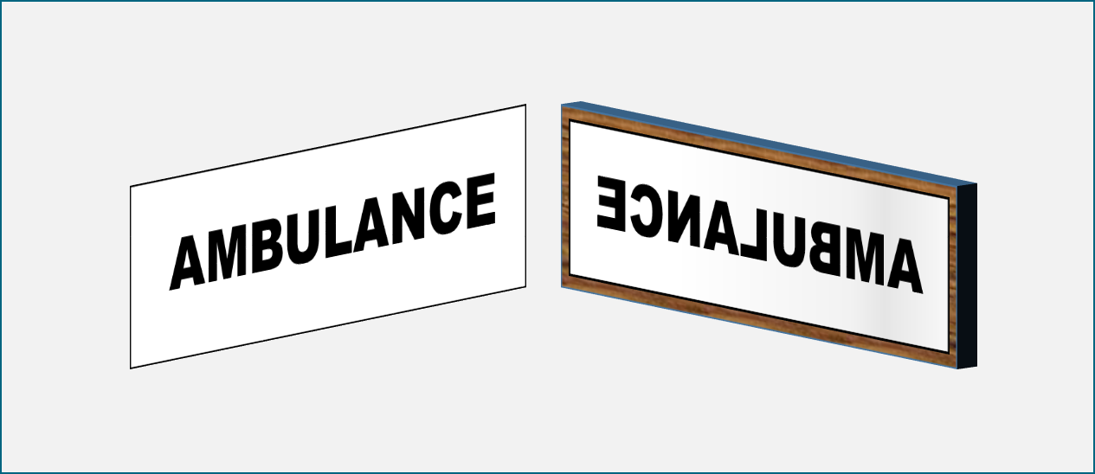
Mirror writing
What can you say about the reflection?
I am sure this is right
I think this is right
I think this is wrong
I am sure this is wrong
A
The mirror turns the reflection round
B
The mirror reflects back what is in front of it
C
Looking through the back of the writing, we see the same as the reflection

